Slide 1
Chapter 20

Slide 2
20-1
How do gaseous and desorption sources differ? What are the advantages of each?
With gaseous ionization sources, the sample is first volatilized (by heating if necessary) and then transmitted to the ionization area for ionization. In a desorption source, a probe is used and ionization takes place directly from the condensed phase.
The advantage of desorption ionization is that it can be applied to high molecular weight and thermally unstable samples.
The advantage of gaseous ionization sources are their simplicity and speed (no need to use probe and wait for probed area to be pumped out).
帶氣態電離源，首先揮發樣品（如有必要，通過加熱）然後傳輸到電離區域進行電離。在解吸源中，探針離子化直接從凝結相發生。解吸電離的一個優點是可以應用於高分子量和熱不穩定的樣品。氣態電離源的優勢在於其簡單性和速度（無需使用探針並等待被抽出的區域）。

Slide 3
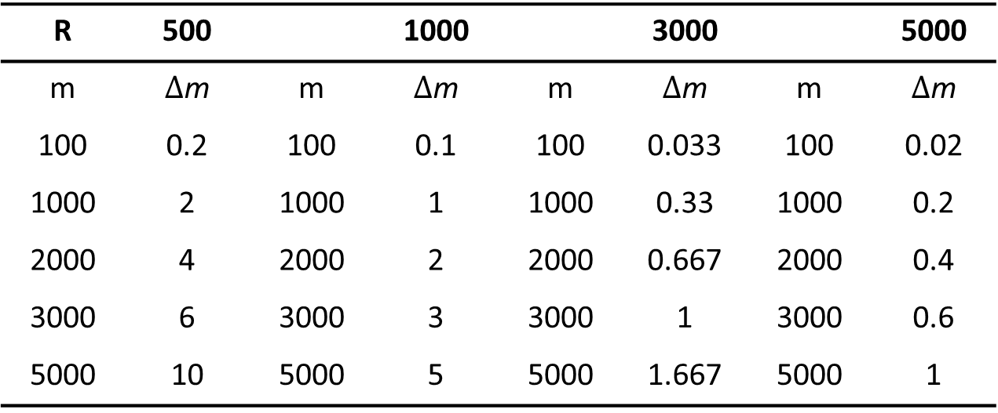

20-12
What mass differences can just be resolved at m values of 100, 1000, 2000, 3000 and 5000 if the mass spectrometer has a resolution of
500
1000
3000
5000
Resolution: m/$∆$m
R | 500 |  | 1000 |  | 3000 |  | 5000
m | $∆$m | m | $∆$m | m | $∆$m | m | $∆$m
100 | 0.2 | 100 | 0.1 | 100 | 0.033 | 100 | 0.02
1000 | 2 | 1000 | 1 | 1000 | 0.33 | 1000 | 0.2
2000 | 4 | 2000 | 2 | 2000 | 0.667 | 2000 | 0.4
3000 | 6 | 3000 | 3 | 3000 | 1 | 3000 | 0.6
5000 | 10 | 5000 | 5 | 5000 | 1.667 | 5000 | 1

Slide 4
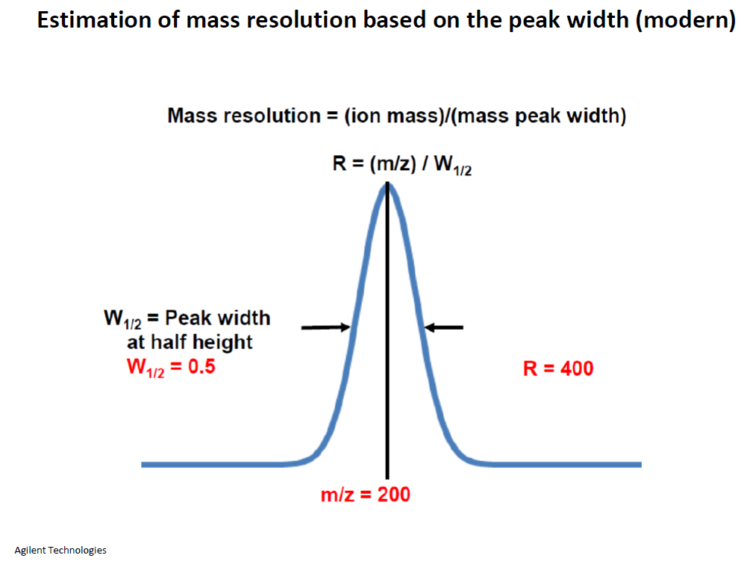
20-12

Slide 5
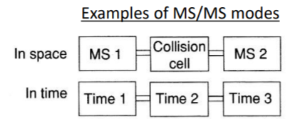
20-16
Discuss the major differences between a tandem-in-space mass spectrometer and a tandem-in-time mass spectrometer. Include the advantages and disadvantages of each type.
在空間儀器中，在空間的兩個不同區域中使用了兩個獨立的質量分析儀。優點是可以輕鬆地獲取所有不同類型的光譜（產物離子，前體離子，中性損失，多維光譜）。效率可能非常低，因此靈敏度可能會很低。串聯的時間儀器在一定的空間區域形成離子，然後在以後的時間排出不需要的離子，並使選定的離子解離並在質譜儀中進行質量分析。相同的空間區域。效率可能很高，並且該過程可以重複很多次。然而，僅直接獲取產物離子光譜。
In tandem in space instruments, two independent mass analyzers are used in two different regions in space. The advantages are that it is relatively easy to take all the different types of spectra (product ion, precursor ion, neutral loss, multidimensional. The disadvantages are that the efficiency can be very low and thus the sensitivity can be low.
Tandem in time instruments form the ions in a certain spatial region and then at a later time expel the unwanted ions and leave the selected ions to be dissociated and mass analyzed in the same spatial region. The efficiency can be fairly high and the process can be repeated many times. It is, however, only straight forward to take product ion spectra. Both approaches require quite expensive instrumentation.

Slide 6
Chapter 26

Slide 7
26-1
Define
Elution
Mobile phase
Stationary phase
Distribution constant
Retention time
Retention factor
Volumetric flow rate
Linear flow velocity
Selectivity factor
Plate height
Column resolution
Longitudinal diffusion
Elution is a process in which species are washed through a chromatographic column by the flow or addition of fresh solvent.(沖提是通過管柱洗滌物質的過程通過流動或添加新鮮溶劑)
The mobile phase in chromatography is the one the moves over or through an immobilized phase that is fixed in place in a column or on the surface of a flat plate.(流動相在層析法中，是通過或通過固定相固定在管柱或平板表面的固定位置)
The stationary phase in a chromatographic column is a solid or liquid that is fixed in place. The mobile phase then passes over or through the stationary phase.(層析法中的固定相是固定在適當位置的固體或液體。然後，流動相越過或穿過固定相)
The distribution constant K in chromatography is the ratio of the concentration (strictly activity) of the analyte in the stationary phase to its concentration (activity) in the mobile phase when equilibrium exists between the two phases.(分佈常數K，當兩相之間存在平衡時，其意義為分析物在流動向和固定向的濃度比例)

Slide 8
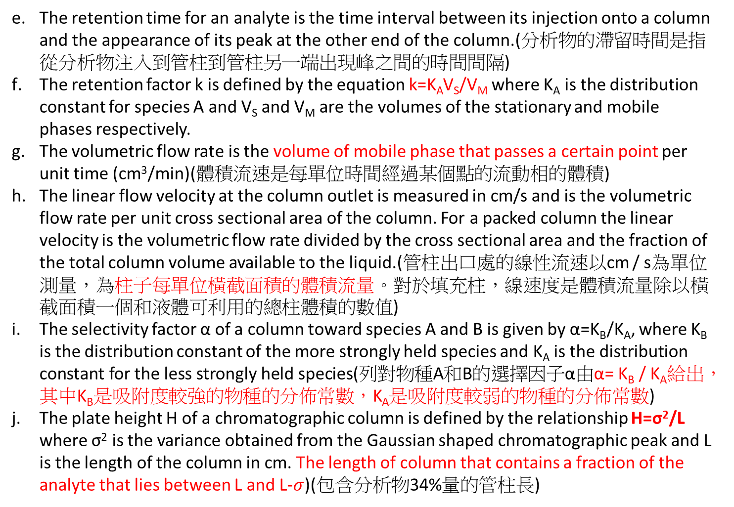
The retention time for an analyte is the time interval between its injection onto a column and the appearance of its peak at the other end of the column.(分析物的滯留時間是指從分析物注入到管柱到管柱另一端出現峰之間的時間間隔)
The retention factor k is defined by the equation k=K_{A}V_{S}/V_{M} where K_{A} is the distribution constant for species A and V_{S} and V_{M} are the volumes of the stationary and mobile phases respectively.
The volumetric flow rate is the volume of mobile phase that passes a certain point per unit time (cm³/min)(體積流速是每單位時間經過某個點的流動相的體積)
The linear flow velocity at the column outlet is measured in cm/s and is the volumetric flow rate per unit cross sectional area of the column. For a packed column the linear velocity is the volumetric flow rate divided by the cross sectional area and the fraction of the total column volume available to the liquid.(管柱出口處的線性流速以cm / s為單位測量，為柱子每單位橫截面積的體積流量。對於填充柱，線速度是體積流量除以橫截面積一個和液體可利用的總柱體積的數值)
The selectivity factor α of a column toward species A and B is given by α=K_{B}/K_{A}, where K_{B} is the distribution constant of the more strongly held species and K_{A} is the distribution constant for the less strongly held species(列對物種A和B的選擇因子α由α= K_{B} / K_{A}給出，其中K_{B}是吸附度較強的物種的分佈常數，K_{A}是吸附度較弱的物種的分佈常數)
The plate height H of a chromatographic column is defined by the relationship H=σ²/L where σ² is the variance obtained from the Gaussian shaped chromatographic peak and L is the length of the column in cm. The length of column that contains a fraction of the analyte that lies between L and L-$σ$)(包含分析物34%量的管柱長)

Slide 9
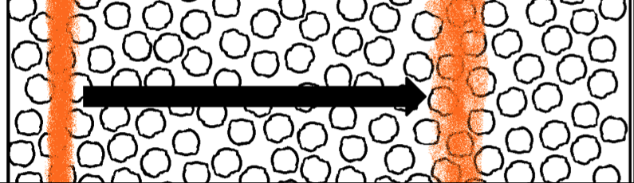
The resolution Rs of a column toward two species A and B is given by the equation Rs= 2ΔZ/(W_{A}+W_{B}) where ΔZ is the distance (in units of time) between the peaks for the two species and W_{A} and W_{B} are the widths (also in units of time) of the peaks at their bases. It provides a quantitative measure of the ability to separate two analytes.( 它提供了分離兩種分析物能力的定量方法。)
Longitudinal diffusion is a source of band broadening in a column in which a solute diffuses from the concentrated center of the band to the more dilute regions on either side. (分析物進入管柱，集中成一條細帶狀前進，在移動時會向兩側濃度較低處擴散，遲滯在管柱內時間越長，擴散程度越嚴重，因此此項與流速成反比)
https://highscope.ch.ntu.edu.tw/wordpress/?p=71880

Slide 10
Question 26-2
Describe the general elution problem.
The general elution problem arises whenever chromatograms are obtained on samples that contain species with widely different distribution constants
若分析物們的分配係數範圍很廣的話會很難把每個都分開。
When conditions are such that good separations of the more strongly retained species are realized, lack of resolution among the weakly held species is observed.
若condition(GC 溫度或LC的跑液組成)設定為適合分離滯留性高的分子，則滯留性低的會分不開。
Conversely when conditions are chosen that give satisfactory separations of the weakly retained compounds, severe band broadening and long retention times are encountered for the strongly bound species
反之亦然。
The general elution problem is often solved in liquid chromatography by gradient elution and in gas chromatography by temperature programming
可用梯度沖提(LC)、設定溫度變化(GC)

Slide 11

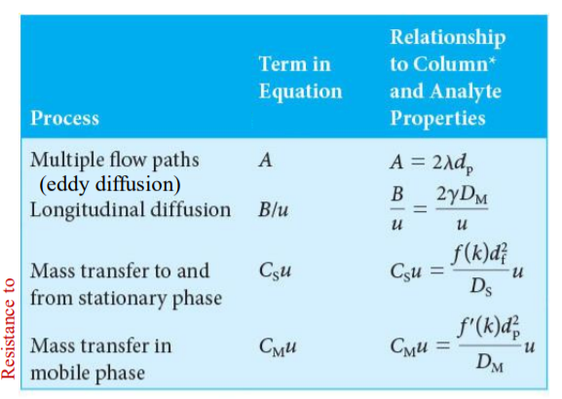
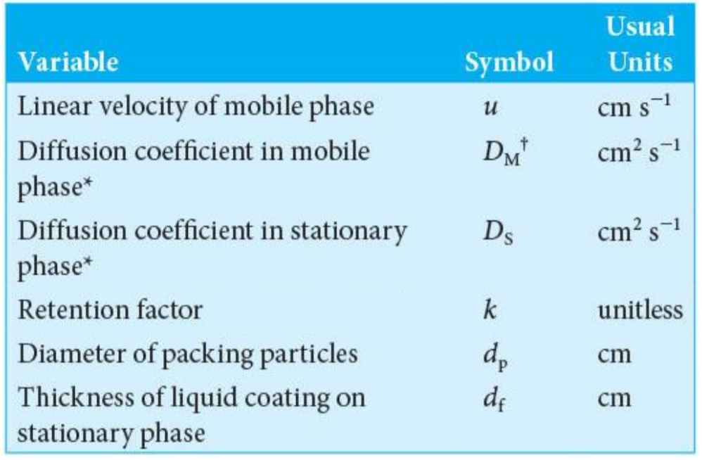
Question 26-3
List the variables that lead to zone broadening in chromatography.
large particle diameters for stationary phases (d_{p})
large column diameters for open tubular columns
high temperatures (important only in GC)
for liquid stationary phases, thick layers of the immobilized liquid(d_{f})
very high or very low flow rates

Slide 12
Question 26-4
What are the major differences between gas-liquid and liquid-liquid chromatography?
Question 26-5
What are the differences between liquid-liquid and liquid-solid chromatography?
gas-liquid chromatography:
mobile phase is gas
stationary phase is liquid
liquid-liquid chromatography:
mobile phase is liquid
stationary phase is liquid
liquid-solid chromatography:
mobile phase is liquid
stationary phase is solid
Liquid stationary phase:
liquid which is immobilized by adsorption or chemical bonding to a solid surface

Slide 13
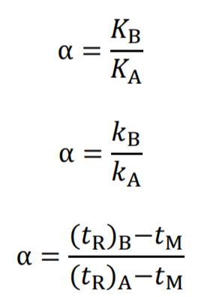
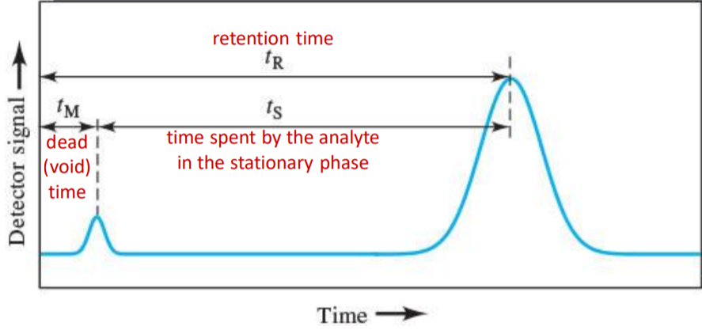
Question 26-6
What variables are likely to affect the selectivity factor α for a pair of analytes?
the composition of the mobile phase
the column temperature
the composition of the stationary phase
chemical interactions between the stationary phase and one of the solutes being separated

Slide 14
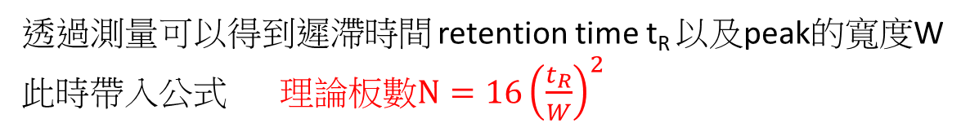
Question 26-8
課本 p.704
Describe a method for determining the number of plates in a column.
理論板數 (theoretical plate, N) 是描述管柱分離效率的指標，理想的分離情況是板數越多，解析度高。
透過測量可以得到遲滯時間 retention time t_{R} 以及peak的寬度W
此時帶入公式 理論板數$N=16{\left(\frac{t_{R}}{W}\right)}^{2}$
通過管柱抵達偵測器的時間，稱為遲滯時間 (retention time）
https://highscope.ch.ntu.edu.tw/wordpress/?p=71880
http://gclc.weebly.com/2365226512370963385323458/-column-efficiency

Slide 15


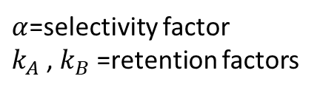

Question 26-9
Name two general methods for improving the resolution of two substances on a chromatographic column.
$$N=16{\left(\frac{t_{R}}{W}\right)}^{2}$$
N 越大 解析度越好
$$N=\frac{L}{H}$$
增加column的長度使理論版數N增加
增加選擇性
例如:將150mm管柱改成250mm管柱，可以增加峰與峰間的分離度
缺點: 分析時間增加、管柱壓力增加
$$α=\frac{k_{B}}{k_{A}}$$
$α$=selectivity factor
$k_{A}$, $k_{B}$=retention factors
峰寬受到填料顆粒大小以及擴散等效應的影響。管柱內的填料顆粒大小(Particle Size)以及顆粒的一致性會影響峰寬的大小
http://gclc.weebly.com/2365226512370963385323458/-column-efficiency

Slide 16
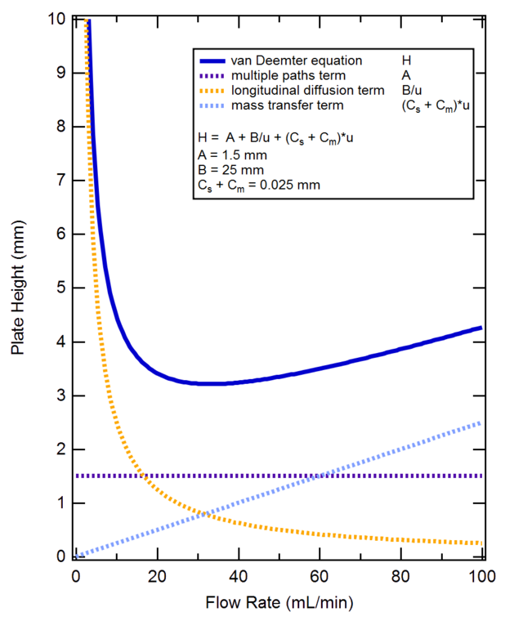
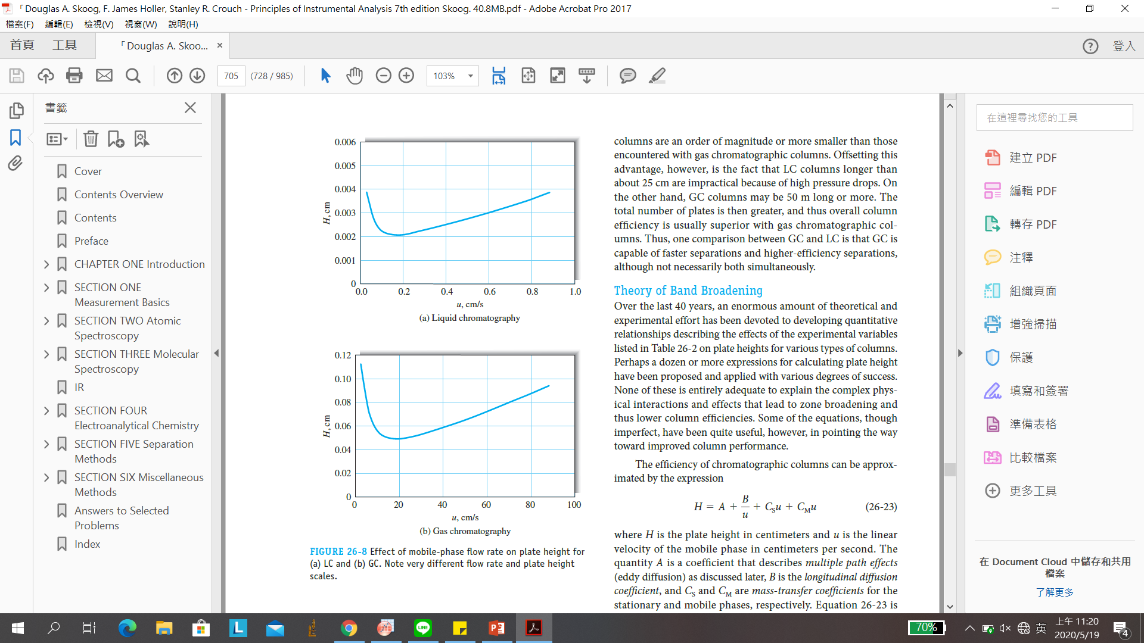


Question 26-10
課本 p.705
Why does the minimum in a plot of plate height versus flow rate occur at lower flow rates with LC than with GC?
$H=A+\frac{B}{u}+\left(C_{s}+C_{m}\right)u$
$u$=動向流速
主要是因為公式中Longitudinal diffusion (B)縱向擴散的影響
Longitudinal diffusion縱向擴散在低流速時會大幅影響版高H， 且由於氣體的擴散係數比液體大很多，因此GC在較高流速時才產生最小版高(H)值。
板高 (height equivalent to a theoretical plate, HEPT, H) 定義為 H=L/N
https://www.wikiwand.com/en/Van_Deemter_equation
https://highscope.ch.ntu.edu.tw/wordpress/?p=71880

Slide 17
Question 26-11
What is gradient elution?
Gradient elution 梯度沖提
用於液相色層分析liquid chromatography (LC)。 依次用幾種不同極性的溶劑把想要的物質從色譜柱中沖洗出來. 因為每種物質的極性都不同, 所以當用上適當極性的溶劑, 就可以把想要的物質沖洗出來, 分離效果就會最好。
Notes:
什麼是梯度洗脫？
梯度洗脫是一種進行液相色譜的方法，其中流動相的組成連續或逐步改變以優化分離。

Slide 18
Question 26-12
List the variables in chromatography that lead to zone separation.
管柱的packing (靜相填充物)造成分布係數有明顯的不同
管柱長度的增加
在LC中，動相的組成比例變動
在GC中，管柱的溫度變動
在LC中，動相的pH改變
在LC中，靜相中的物質選擇性的和某些分析物產生作用
Notes:
列出導致區域分離的色譜中的變量。
區域分離受（1）填料影響，產生的分配係數顯著不同; （2）柱長增加; （3）流動相組成（LC）的變化; （4）優化柱溫（GC）; （5）流動相（LC）的pH值變化; （6）在固定相中摻入物質，選擇性地使某些分析物（LC）絡合。

Slide 19
Question 26-13
What would be the effect on a chromatographic peak of introducing the sample at a too slow rate?
進樣速度太慢會造成band broadening (譜帶寬化)
Notes:
太慢的速率引入樣品的色譜峰會有什麼影響？
緩慢的樣品引入導致譜帶展寬。

